Slide 1


CHM 103: Organic Chemistry I
Presented by:
Assoc Prof Okoli BJ MRSC, MACS
Department of Chemical Science,
Faculty of Science & Technology
Bingham University
The University with the difference
Bingham University

Slide 2

CHEMISTRY OF ALKYNES
there is at least one triple-bond between the atoms in the molecules.
are unsaturated because of the existence of a multiple bond in the molecule.
general molecular formula of the alkene series of hydrocarbons is CnH2n-2.
The first member is ethyne (previously called acetylene).
all alkynes end in "-yne".
Types of alkyne
terminal alkyne: A terminal alkyne is an alkyne in whose molecule there is at least one hydrogen atom bonded to a triply bonded carbon atom.
internal alkyne: An internal alkyne is an alkyne in whose molecule there are no hydrogen atoms bonded to triply bonded carbon atoms.
Alkynes Physical Properties
insoluble in water.
soluble in the usual organic solvents of low polarity (e.g. ligroin, ether, benzene, carbon tetrachloride, etc.).
less dense than water.
boiling points show the usual increase with increasing carbon number.
Bingham University

Slide 3
Alkynes: Acidity
Alkynes of the general structure
referred to as terminal alkynes. These types of alkynes are weakly acidic. Exposure to a strong base, such as sodium amide, produces an acid‐base reaction.
Bingham University

Slide 4
Alkynes: Acidity
Alkynes of the general structure
referred to as terminal alkynes.
are weakly acidic. And produces an acid‐base reaction.
Bingham University

Slide 5
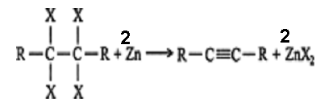
Alkynes: Preparations
Dehydrohalogenation. The loss of a hydrogen atom and a halogen atom from adjacent alkane carbon atoms leads to the formation of an alkene. The halogen atoms may be located on the same carbon (a geminal dihalide) or on adjacent carbons (a vicinal dihalide). Vicinal tetrahaloalkanes can be dehalogenated with zinc metal in an organometallic reaction to form alkynes
Substitution. Larger alkynes can be generated by reacting an alkyl halide with an acetylide ion, which is generated from a shorter alkyne.
Ethyne (acetylene) preparation. Ethyne, which is commonly called acetylene, is the simplest alkyne. Historically, it was prepared by reacting calcium carbide with water.
Bingham University

Slide 6
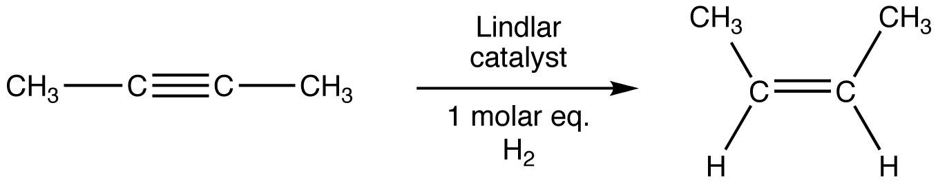
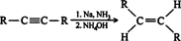
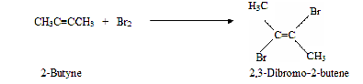
Reactions of Alkynes
Hydrogenation. Alkynes undergo catalytic hydrogenation with the same catalysts used in alkene hydrogenation: platinum, palladium, nickel, and rhodium.
Greater yields of alkenes are possible with the use of poisoned catalysts. One such catalyst, the
1. Lindlar catalyst: finely divided palladium coated with quinoline and absorbed on calcium carbonate.
2. Sodium in liquid ammonia at low temperatures. This reaction is a chemical reduction rather than a catalytic reaction, so the hydrogen atoms are not attached to a surface, and they may approach an alkene from different directions, leading to the formation of trans alkenes.
Halogenation. The addition of halogens to an alkyne proceeds in the same manner as halogen addition to alkenes.
Bingham University

Slide 7
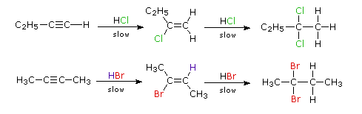
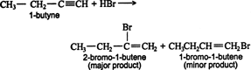
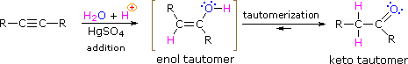
Hydrohalogenation. Hydrogen halides react with alkynes in the same manner as they do with alkenes.
Both steps in the above addition follow the Markovnikov rule. Thus, the addition of hydrogen bromide to 1‐butyne gives 2‐bromo‐1‐butene as the major product of the first step.
Hydration. The addition of the elements of water across the triple bond of an alkyne leads to the formation of aldehydes and ketones. Water addition to terminal alkynes leads to the generation of aldehydes, while nonterminal alkynes and water generate ketones.
Bingham University

Slide 8
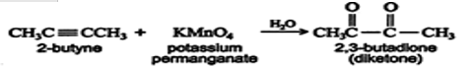
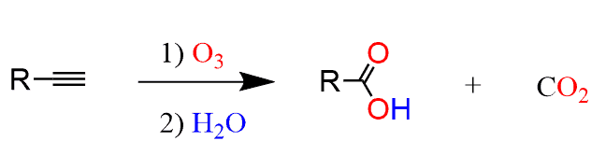
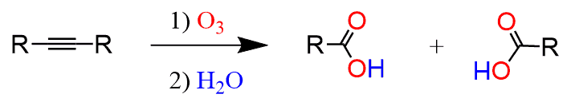
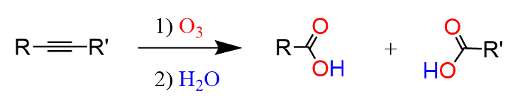
Oxidation. Alkynes are oxidized by the same reagents that oxidize alkenes. Disubstituted alkynes react with potassium permanganate to yield vicinal diketones (Vic‐diketones or 1,2‐diketones) or, under more vigorous conditions, carboxylic acids.
Ozonolysis. It is an Oxidative Cleavage reaction where both the π and σ bonds of the double or a triple bond are broken to form two carbonyl groups. Ozonolysis of an alkyne also leads to carboxylic acid formation. or external alkynes, the ozonolysis results in a carboxylic acid and carbon dioxide:
The ozonolysis of internal alkynes, on the other hand, produces two carboxylic acids:
So, here if the alkyne is symmetrical, meaning the R groups are identical then two molecules of the same carboxylic acid are formed. If the alkyne is not symmetrical, then two different carboxylic acids are formed:
Polymerization. Alkynes can be polymerized by both cationic and free‐radical methods. The reactions and mechanisms are identical with those of the alkenes.
Bingham University

